Slide 1

Analysis of Northwind Consumer Purchasing Behavior for Northwind
James M. Irving, Ph.D.
Michael Morvetz
04/08/19

Slide 2
QUESTIONS ABOUT CONSUMER PURCHASING BEHAVIOR
Q1: “Do discounts have a statistically significant effect on the number of products customers order? If so, at what level(s) of discount?”
Q2: Do customers spend more money if they are buying discounted items?
Q3: Do customers buy different quantities depending on the time of year
Q4: Do different countries….

Slide 3
OUR METHODOLOGY
Explored SQL Database for data re: insights into consumer behavior.
Defined formal hypothesis and used the scientific method.
Performed analysis of data distributions to decide appropriate test.
D’Agostino & Pearson’s normality test.
Levene’s test for equal variance.
Performed proper statistical tests to test our hypotheses.
Mann-Whitney U
Tukey’s Pairwise Multiple Comparison tests.

Slide 4
HYPOTHESIS 1: Do discounts have a statistically significant effect on the number of products customers order? If so, at what level(s) of discount?
𝐻1 : Products that are discounted sell in higher quantities.
𝐻0 : Products that are discounted sell the same quantities as full-price products.

Slide 5
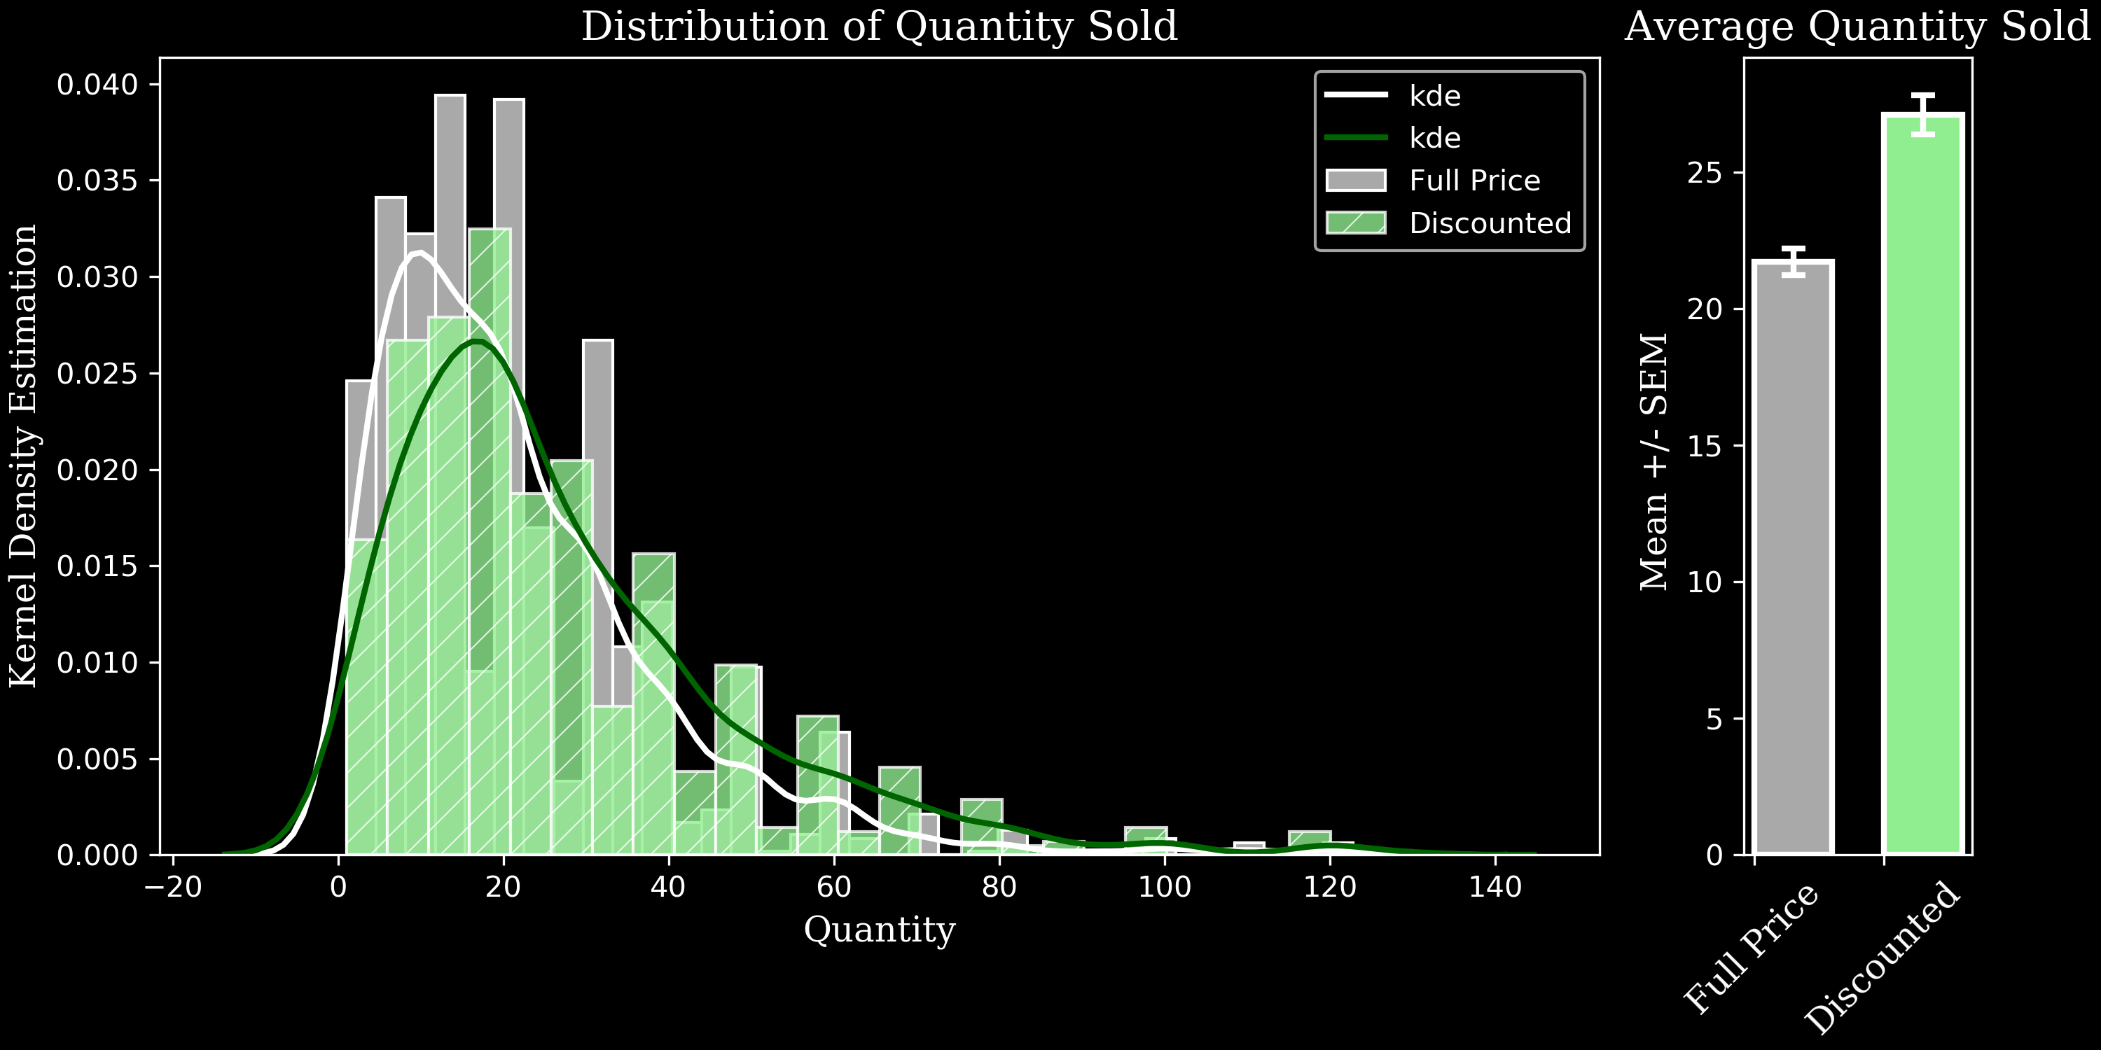
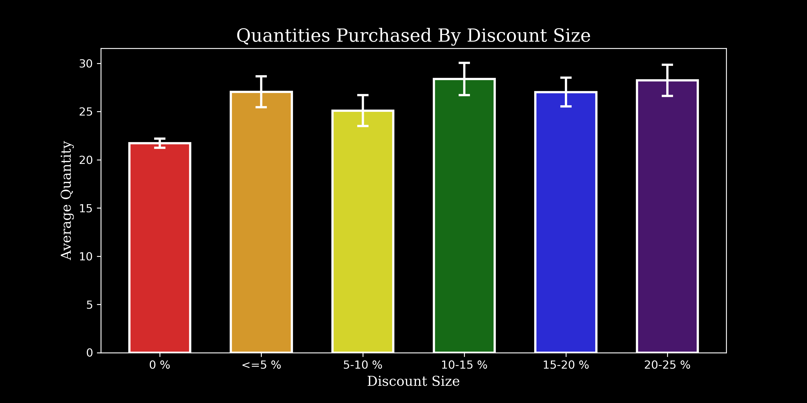
Results:

Slide 6
Hypothesis 2: Do discounts have a statistically significant effect on the number of products customers order? If so, at what level(s) of discount?
𝐻1 : Customers spend more money overall when their order includes discounted items.
𝐻0 : Customers spend the same amount regardless of discounted items.

Slide 7
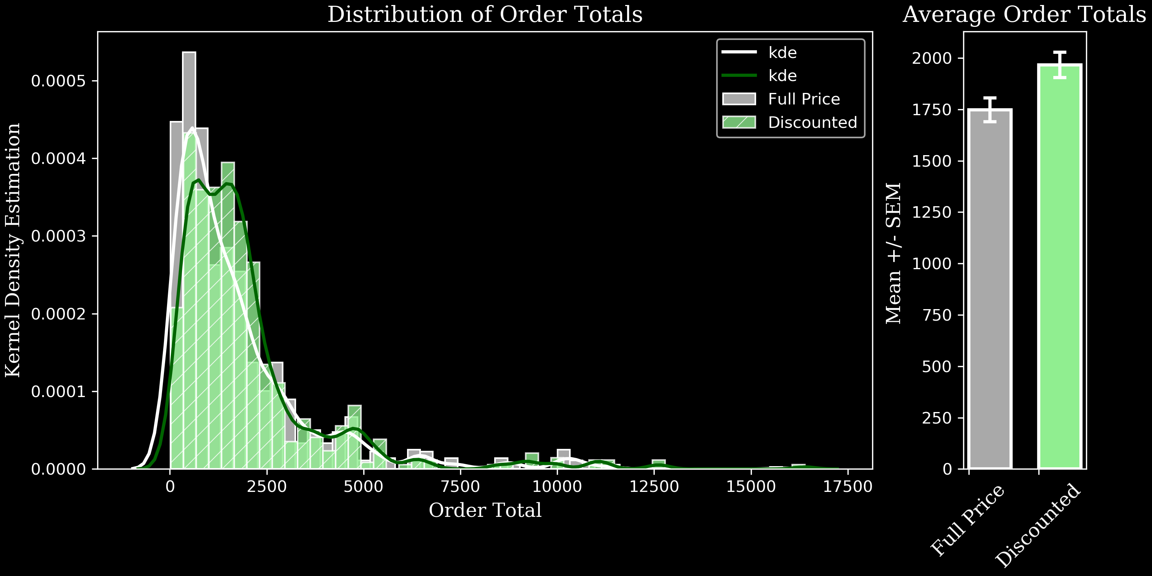
Results:

Slide 8
Hypothesis 3

Slide 9
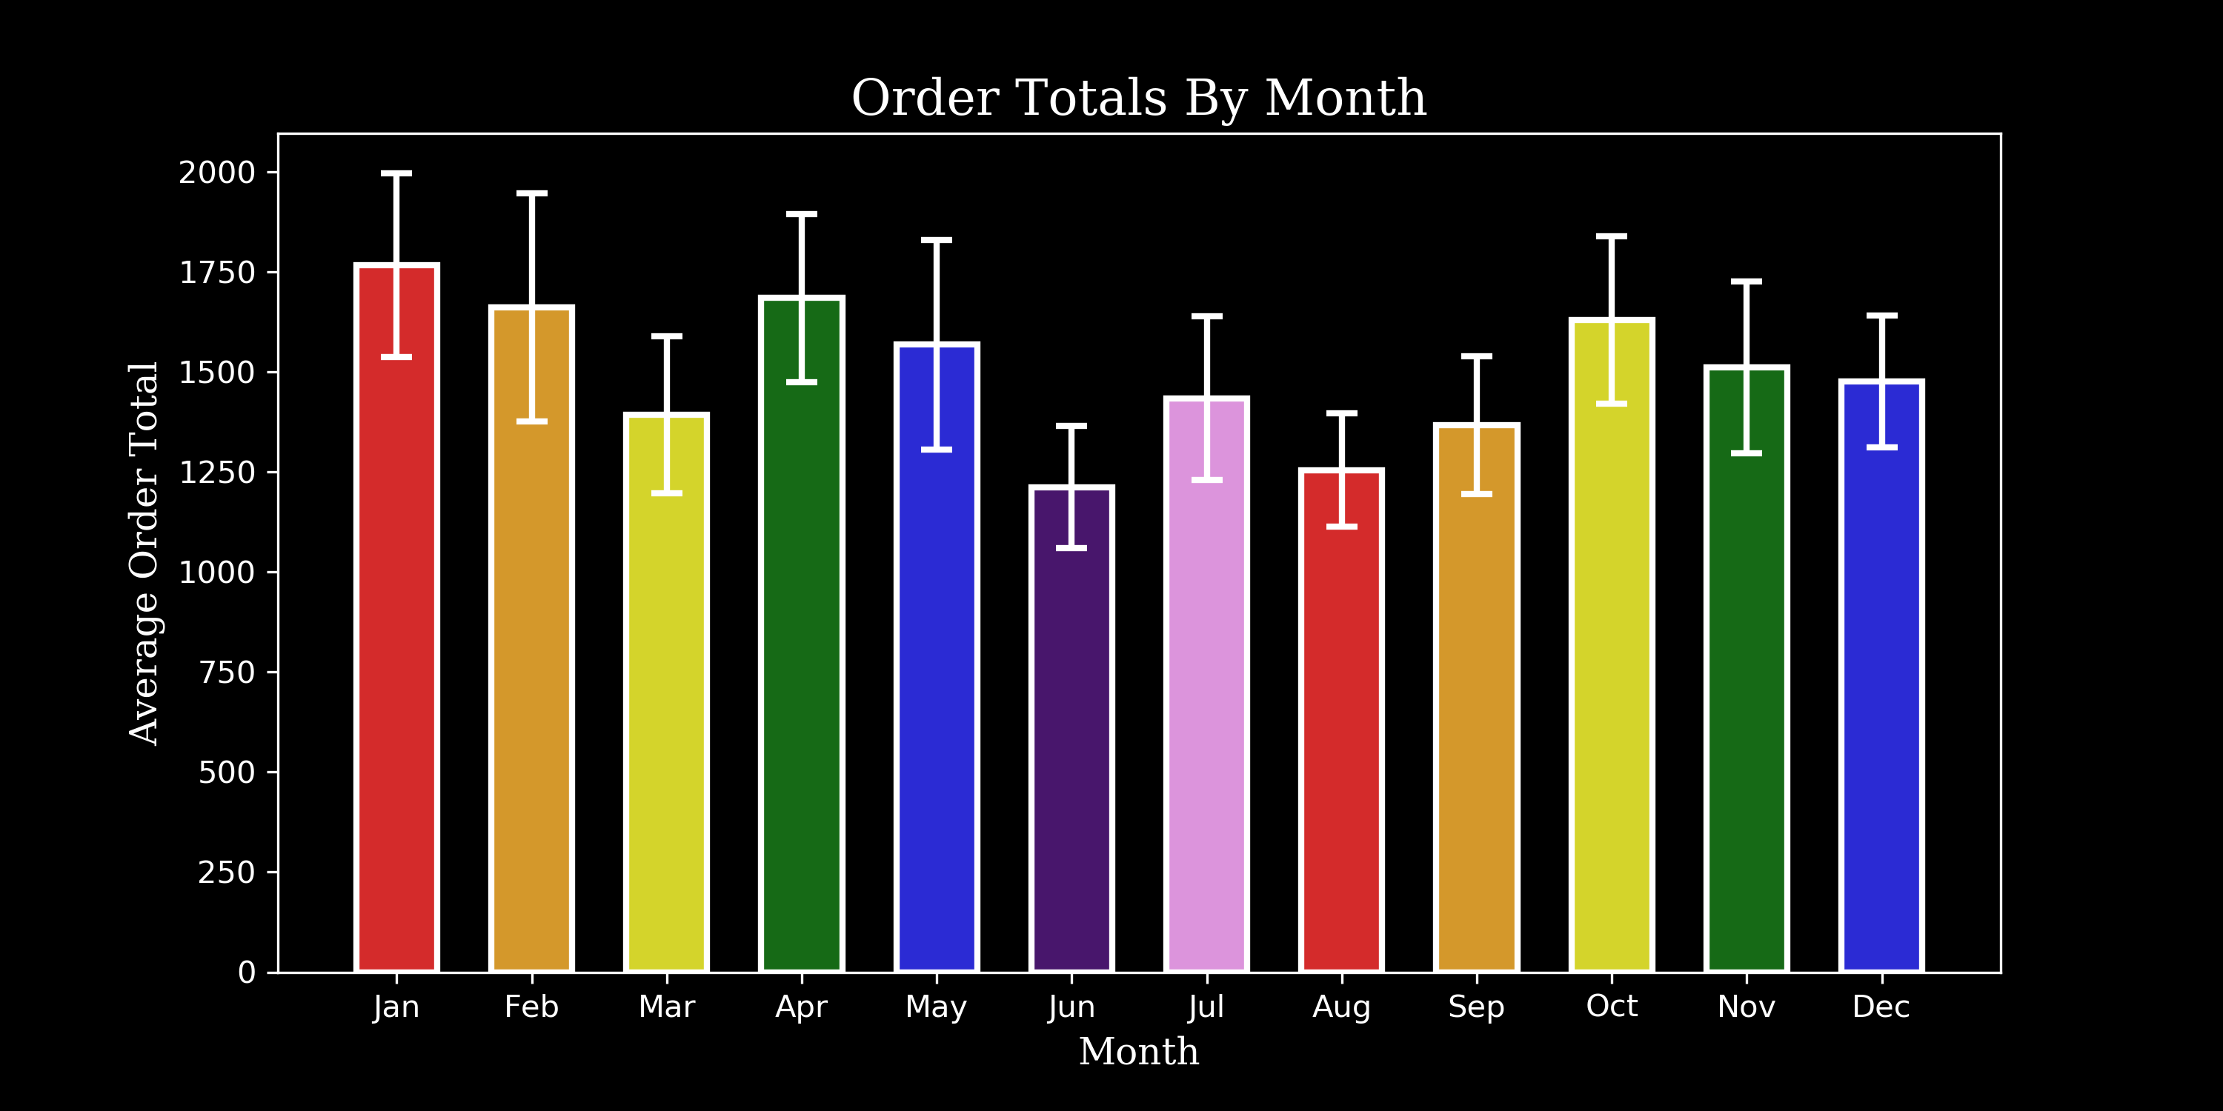

Slide 10
Hypothesis 4

Slide 11
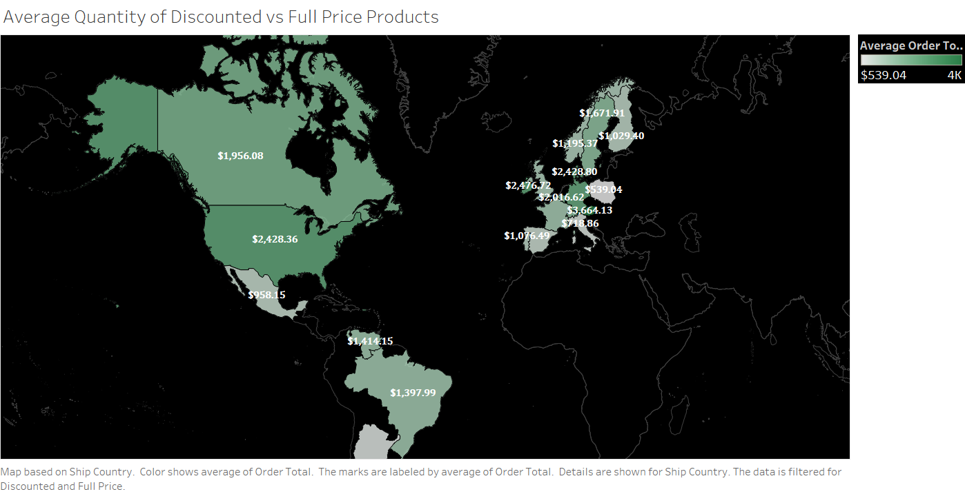

Slide 12


Slide 13
REQUIREMENTS.
Executive Summary Must-Haves
Contain between 5-10 professional quality slides detailing:
A high-level overview of your methodology
The results of your hypothesis tests
Any real-world recommendations you would like to make based on your findings (ask yourself--why should the executive team care about what you found?
How can your findings help the company?)
Take no more than 5 minutes to present
Avoid technical jargon and explain results in a clear, actionable way for non-technical audiences.

